Slide 1

CoB-KIBM Workshop:
Fellowships & Grants
Pam Rivière and Eena Kosik
Notes:
mini intros:
Hi! I’m Pam, a 7th year PhD student in the CogSci program, and one of the co-founders of Colors of the Brain!
Hi! I’m Eena, a 3rd year PhD student in the CogSci program, and the mentorship coordinator of Colors of the Brain this year!
Today we’ll be talking a bit about fellowships and grants, which are sources of money that you can apply to as a graduate student (most frequently), and also sometimes even before you have started your graduate program.

Slide 2
Types of Fellowships
fellowships → financial independence!
Federal
must be a U.S. citizen for many of these
Ex: Graduate Research Fellowship Program by National Science Foundation
Ex: NRSA F31 by National Institutes of Health
Intramural
specific to your research institution (i.e. UCSD-specific funding)
Ex: Innovative Research Grants by Kavli Institute for Brain and Mind
Notes:
5 min
So you guys already know that getting funding is awesome, because having money allows you a large degree of financial independence as you’re pursuing your research! Different graduate programs have a variety of different funding schemes, but across the board, at some point in your graduate career you will likely want to apply to a research fellowship or grant.
This table here provides a summarized overview of the broad categories of fellowships that would be available to you as you plan to start your grad program, or as you are in thick of your grad program.
The two broadest categories of fellowships are federal and intramural. Federally funded fellowships are those that are granted by a government body. For example, the U.S. National Science Foundation and the U.S. National Institutes of Health offer funding options for grad students through the Graduate Research Fellowship Program (GRFP) and the more complicated but very worth it NRSA F31 fellowship from the NIH. Later in this workshop, we’ll focus a little bit more on the components of the most common and probably the most tractable entrypoint into federal fellowship applications: the NSF GRFP.
Institutions with graduate programs such as UCSD, any of the UC system universities, and public and private universities across the nation typically also have intramural fellowships. Intramural just means “within the walls”, which refers to the fact that only (or primarily) students who are registered at that institution can compete for these fellowships. These are typically shorter in funding duration, like a year or two, and they don’t always cover your tuition expenses as a grad student, unlike the federal NSF and NIH doctoral grants. One great example at UCSD is the Innovative Research Grant offered by the Kavli Institute for Brain and Mind (which has also funded your CoB-KIBM experience this summer!).

Slide 3
Types of Fellowships
fellowships → financial independence!
Federal
must be a U.S. citizen for many of these
Ex: Graduate Research Fellowship Program by National Science Foundation
Ex: NRSA F31 by National Institutes of Health
Summer Programs
once accepted into a graduate program, can get summer funding this way
Ex: Competitive Edge by UCSD
Intramural
specific to your research institution (i.e. UCSD-specific funding)
Ex: Innovative Research Grants by Kavli Institute for Brain and Mind
International-Friendly
non-U.S. citizens can apply
Ex: Fullbright
Notes:
5 min
Two sub-categories of fellowship include summer programs, and international-friendly or international-only fellowships. Both of these sub-types of fellowships can be federal or intramural, or funded by private foundations and companies (which is a category that we don’t cover here in depth, but which is great to check out every so often, like the Hellman Fellows Program, the Wellcome Trust, or even Google’s PhD Fellowship Program).
Summer programs are really similar to the CoB-KIBM fellowship, but apply once you have been accepted into a graduate program. For example, UCSD hosts a summer fellowship called Competitive Edge, which supports graduate students the summer immediately before starting their PhD program at UCSD. So that’s something that all of you can apply to if you end up deciding to apply to any of UCSD’s various grad programs.

Slide 4
National Science Foundation Graduate Research Fellowships Program (NSF-GRFP)
basic eligibility:
be a US citizen, US national, or permanent resident
intend to pursue a research-based Master’s or Ph.D. program in a GRFP-supported field
be enrolled in an eligible program at an accredited United States graduate institution, with a US campus, by fall following selection
be at an early stage in your graduate career
have completed no more than one academic year of full-time graduate study (or the equivalent)
Notes:
Today, we’ll do a deep dive into the NSF GRFP. We chose this fellowship for a couple of reasons:
it has really few components (unlike the NRSA F31),
you’re super likely to apply to it if you intend to enroll in a grad program
and going through this example in depth will illustrate how to go about applying for this and more complex fellowship applications
So one of the first things you’ll do once you find a fellowship opportunity is to check out the eligibility criteria – basically, do you meet all the requirements to be funded in the first place?
The NSF’s basic eligibility criteria are the following (read off slides).

Slide 5
NSF-GRFP: Application Components
Two essays:
Personal Statement, Relevant Background, and Future Goals (3 pages)
Research Proposal (2 pages)
Three letters of reference:
Ideally principal investigators, people you know fairly well, & can speak to specific experiences and strengths
These will be reviewed on the criteria of:
Intellectual Merit
“the potential to advance knowledge”
Broader Impacts
“the potential to benefit society and contribute to the achievement of specific, desired societal outcomes”
Notes:
https://www.alexhunterlang.com/nsf-fellowship

Slide 6
NSF-GRFP: Personal Statement Advice
Personal Statement (~1 page). This is where you tell your unique story of either how you became interested in science, what makes you special, and/or any unique perspective you bring to science. Great place to mention if you had to overcome any hardships or would be adding to the diversity of the STEM field. Definitely use this section to highlight Broader Impacts.
Relevant Background (~1 page). Hopefully you already have research experience, so explain how that has prepared you for success in graduate school and beyond. Mainly use this section for Intellectual Merit, but also highly the Broader Impacts of your research experience.
Future Goals (~1/2 page). This is where you tie your personal background and scientific background into one cohesive vision for the future.
Intellectual Merit (~1/4 page). Conclude the essay by summarizing all of your contributions to Intellectual Merit. Make sure this is an explicit header.
Broader Impact (~1/4 page). Conclude the essay by summarizing all of your contributions to Broader Impact. Make sure this is an explicit header.
Notes:
https://www.alexhunterlang.com/nsf-fellowship

Slide 7
NSF-GRFP: Research Proposal Advice
Introduction: Introduce the scientific problem and its impact on science and society
Research Plan: Show the major steps that need to be accomplished
What is the creative part of your approach?
Have you thought of alternatives for hard or crucial steps?
What skills do you have to make this plan successful?
Intellectual Merit: Have a clear header for this section
Clearly demonstrate that tackling this problem will make an impact and advance science
Try to summarize how you hit all five Review Criteria
Broader Impacts: Have a clear header for this section
Paragraphs to address how this research impacts all five Review Criteria.
Conclusion (Optional). Could use the Intellectual Merit and Broader Impacts sections as conclusion. If not, end with several sentences summarizing your project.
Notes:
https://www.alexhunterlang.com/nsf-fellowship

Slide 8
Personal Statement
NSF-GRFP

Slide 9
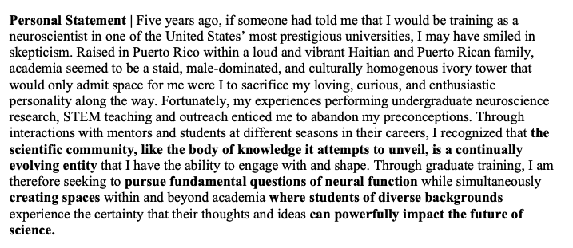
NSF-GRFP: Anatomy of a Personal Statement
personal statement, pam strategy → have a thesis that ties the 3 subsections together; pam’s thesis: personal motivation centered around networks
in paragraph 1: (1) introduce my core identity, (2) introduce my interest in basic research and (3) indicate my goal for broader impact in the field, e.g. diversifying the field

Slide 10
NSF-GRFP: Anatomy of a Personal Statement
personal statement, pam strategy → have a thesis that ties the 3 subsections together; pam’s thesis: personal motivation centered around networks
in paragraph 1: (1) introduce my core identity, (2) introduce my interest in basic research and (3) indicate my goal for broader impact in the field, e.g. diversifying the field

Slide 11
NSF-GRFP: Anatomy of a Personal Statement
personal statement, pam strategy → have a thesis that ties the 3 subsections together; pam’s thesis: personal motivation centered around networks
in paragraph 1: (1) introduce my core identity, (2) introduce my interest in basic research and (3) indicate my goal for broader impact in the field, e.g. diversifying the field

Slide 12
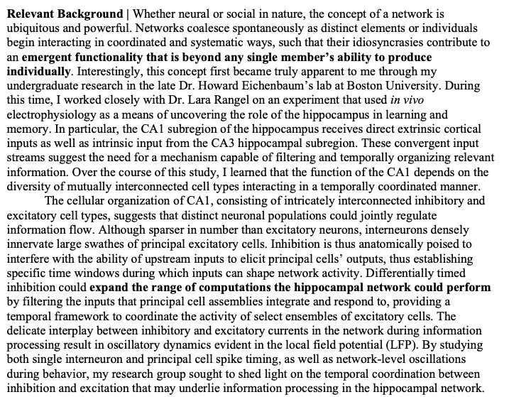
NSF-GRFP: Anatomy of a Personal Statement
personal
personal statement, pam strategy → have a thesis that ties the 3 subsections together; pam’s thesis: personal motivation centered around networks
next, in the relevant background section, I introduce the concept of networks, and then go into the details of the research that I did in my undergrad that taught me about networks
in this section, you are showing the reviewers that you can effectively toggle between the details of your work and the impact of your work

Slide 13
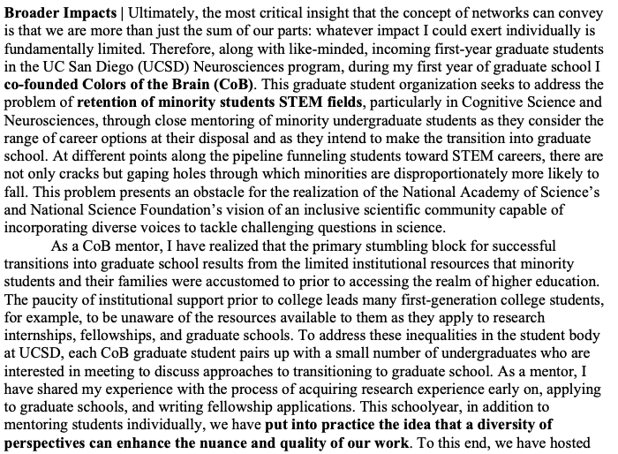
NSF-GRFP: Anatomy of a Personal Statement
personal statement, pam strategy → have a thesis that ties the 3 subsections together; pam’s thesis: personal motivation centered around networks
in the broader impacts section, I bring back the overarching theme of networks
similarly to the relevant background research experience section, I focus on toggling between identifying social challenges and offering details about how we’ve gone about addressing these challenges

Slide 14
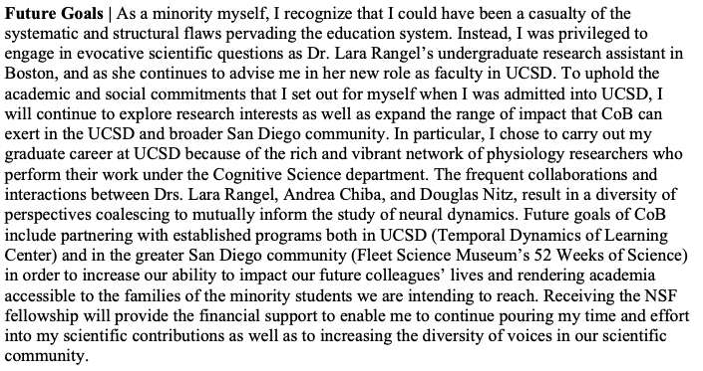
NSF-GRFP: Anatomy of a Personal Statement
personal statement, pam strategy → have a thesis that ties the 3 subsections together; pam’s thesis: personal motivation centered around networks
in the future goals section, tie it all together!
I: remind them of my identity, which I introduced in the first paragraph, say why UCSD will be a wonderful place for research, and what we plan to do with CoB

Slide 15
Research Proposal
NSF-GRFP

Slide 16
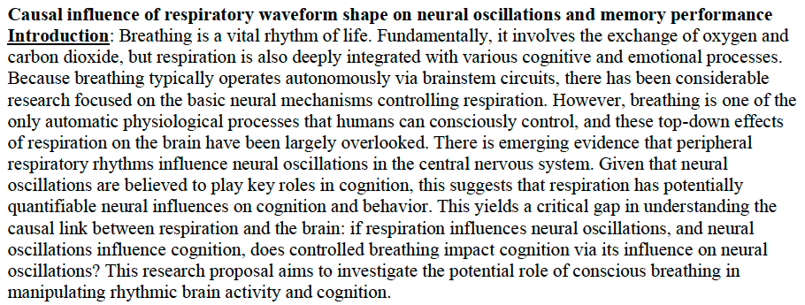
NSF-GRFP: Anatomy of a Research Proposal
Introduction:
(1) Easy to grasp, straightforward introductory sentence(s). (2) The gap in the literature that you are filling. (3) Your actual proposal.

Slide 17
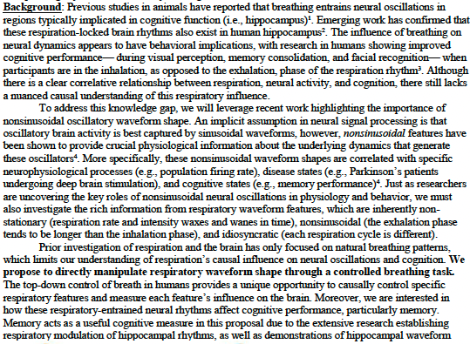
NSF-GRFP: Anatomy of a Research Proposal
Background:
(1) Setting the tone with other research to eventually (2) propose your own idea and how it fits in the context of the literature.

Slide 18
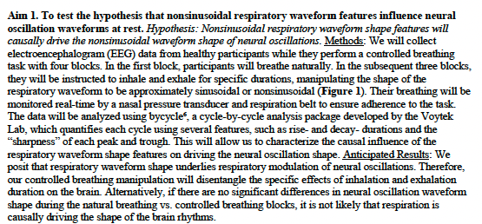
NSF-GRFP: Anatomy of a Research Proposal
Aims: (1) Useful to frame aims as “to test the hypothesis”. (2) Your expectation from this hypothesis. (3) Methods to test this hypothesis. (4) Anticipated results from this experiment, make sure to highlight if your hypothesis is wrong.

Slide 19
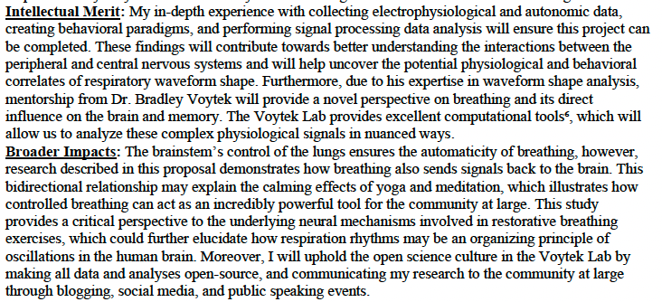
NSF-GRFP: Anatomy of a Research Proposal
Intellectual Merit:
(1) Your specific experience and why it means you will be successful.
(2) Your mentor and lab and why it means you will be successful.

Slide 20
NSF-GRFP: Anatomy of a Research Proposal
Broader Impacts:
(1) How your research positively influences the community (NO focus on clinical). (2) How you as a researcher will positively impact the community.

Slide 21
Kavli Institute for Brain and Mind (KIBM) Innovative Research Grant Program
basic eligibility:
be a UCSD graduate student
how to succeed:
Emphasize your work’s potential to bridge the brain-mind gap using novel techniques
Interdisciplinarity
Novelty
High risk/high payoff
Not currently fundable through other established funding mechanisms
Notes:
Each grant is different, but this one prioritizes novelty, innovation, and high risk

Slide 22
Strategies for Writing Fellowships

Slide 23
Strategies!
Write out all high-level components of the application.
Go through each component:
What are the length requirements?
What are the instructions?
What is the deadline?
Make a schedule:
Work backwards from the deadline and map out how long to work on each component.
Include asking for letters of recommendation in this schedule.

Slide 24
Strategies!
what is the deadline?
sun
mon
tues
wed
thurs
fri
sat
real deadline!

Slide 25
Strategies!
what is the deadline?
sun
mon
tues
wed
thurs
fri
sat
jot it down!
fake deadline!
(but maybe label it as real deadline, for yourself)
real deadline!
5 pm E.T.

Slide 26
Strategies!
write out all high-level components of the application & work backwards!
sun
mon
tues
wed
thurs
fri
sat
send out email requests for Reference Letters
completed draft Personal Statement – send to beta readers
follow up on Reference Letters; emails to new people if needed
completed draft Research Proposal – send to beta readers
revised draft Personal Statement – send to beta readers again
revised draft Research Proposal – send to beta readers again
fake deadline!
(but maybe label it as real deadline, for yourself)
send your reference letter writers friendly reminders, attaching your final docs is a nice way to do this
real deadline!
5 pm E.T.
Notes:
This is an example schedule you could make for yourself. This example assumes that you basically have a single month to work on the NSF application.
Feedback and revision are really important features of graduate school: try to get feedback givers who can ask you sharp questions that will help you refine and clarify your thoughts, and occasionally provide new insights you may not have considered! It’s not a failure if you have to rewrite your entire proposal or personal statement – it’s a chance for growth and progress!

Slide 27
Strategies!
write out all high-level components of the application & work backwards!
sun
mon
tues
wed
thurs
fri
sat
send out email requests for Reference Letters
completed draft Personal Statement – send to beta readers
drafting Personal Statement
follow up on Reference Letters; emails to new people if needed
revising Personal Statement according to feedback
completed draft Research Proposal – send to beta readers
drafting Research Proposal
revised draft Personal Statement – send to beta readers again
revised draft Research Proposal – send to beta readers again
revising Personal Statement
revising Research Proposal
revising Personal Statement
fake deadline!
(but maybe label it as real deadline, for yourself)
send your reference letter writers friendly reminders, attaching your final docs is a nice way to do this
real deadline!
5 pm E.T.
celebrate!
relax!
tying up loose ends — revising/polishing Research Proposal, Personal Statement OR submission!
Notes:
Now, say you don’t meet your goal for one of these colored boxes – are you going to be disappointed and give up? NO!!! You will have simply learned that a task took you longer (or less time!) than you expected. This is information about yourself! It is information about how much time you need to complete certain tasks, and in future application seasons, you can incorporate that knowledge about yourself to help you plan in a way that fits your preferences, personality, family obligations, etc.

Slide 28
Now, your turn!
Choose a fellowship and make your own schedule.
~15 minutes
Notes:
For this exercise, try to identify how you will physically organize the schedule – you can do this on a google calendar, you can do it on a notebook, or piece of paper, or a google sheets, or a google doc, or whatever other app/tool that you will regularly check, and where you will feel a deep satisfaction if you can cross off an item as completed!
Then go online, and find a grant that you might either actually apply to, or you could just pretend play here and pick something that you won’t apply to in the near future but that would require planning and time management to figure out how to complete all the components in time.
Then make your own schedule! (1) list all the components, (2) figure out what each component’s length is (3) mark the deadline (and the fake deadline!) in your scheduling tool, (4) then arrange all the components by your intended completion date for each major draft.

Slide 29
General Resources
Other fellowships:
American Association of University Women (AAUW) - International Fellowships
Autism Speaks - Dennis Weatherstone Predoctoral Fellowships
Council of Graduate Schools (CGS)/Proquest Distinguished Dissertation Award
Facebook Graduate Fellowship Program
Fulbright Program for Foreign Students
Latin American Scholarship Program of American Universities (LASPAU)
National Defense Science and Engineering Graduate Fellowship Program
Department of Energy Computational Science Fellowship
General searches for funding:
Funding US Study
Illinois Fellowship Finder
Other links:
NSF-GRFP guide
CoB Google Drive with many different types of application examples
CoB presentation on undergraduate summer research funding

Slide 30
Questions?

